Slide 1
Capstone Project
Restaurant investment

Slide 2


Background
New York City has long been one of the most sought-after places to open a restaurant. It’s also the most populous city in the country with more than eight million people and counting. For the past two centuries, New York has been the largest and wealthiest American city. More than half the people and goods that ever entered the United States came through its port, and that stream of commerce has made a constant presence in city life. That's a lot of hungry mouths to feed, so it’s no wonder more and more restaurant owners are setting up shop and it's worth investing into the field to get profits.

Slide 3


Problem
Interest
Restaurant investors are interested in looking for a type of restaurant aligned with local regulation as well as competitive reputation among residents.
As many restaurants as there currently are in New York City, which types of restaurants to invest plays a significant role in the success or failure of an investment. If a company made the wrong decision, it might end up getting the opposite of what investors want. Especially with unstable factors such as number of customers, workers, transportation, materials, and so on. Consequently, investing into the correct type of restaurant is critical to the investment funds.

Slide 4
Data Description
For restaurants location, type of cuisine, grade of inspection and location, we can find it on kaggle database use the URL: https://www.kaggle.com/new-york-city/nyc-inspections/version/1 and we will be using the dataset to perform analysis for our end client restaurant choice.
ACTION : type of inspection
VIOLATION CODE : violation code
VIOLATION DESCRIPTION : description
CRITICAL FLAG : level of severity
SCORE : score
GRADE : grade
GRADE DATE : grade date
RECORD DATE : record date
INSPECTION TYPE: inspection type
CAMIS : Restaurant number
DBA : type of service offered
BORO : general area
BUILDING : specific location
STREET : specific street name
ZIP CODE : individual zip code
PHONE : individual phone number
CUISINE DESCRIPTION: type of cuisine
INSPECTION DATE: date of inspection
Tip
Account needed for download file from Kaggle online.
- Email address
- password

Slide 5
Proposal
It is important to know what is in the market right now before we further dig into the data. Our goal is to locate one or a group of restaurants that are popular in the city and have a great location.
For this dataset, we will analyze the mean of different restaurants' violation score for inspections to find correlation between location, description and sanitation. According to the data report, the higher the score, the more critical the inspection violation. Now, the drawback of visualizing the average violation score across the various restaurant types is the population of samples from each category. For instance, there are over 90,000 American restaurants while only 49 samples of restaurants that serve Iranian food. Therefore, simply looking at the mean score value may be skewed by the number of violation samples and may not be useful for investment purposes. Second, we factor in location at different granularities (e.g. borough and postal code) for the investors to get a sense of density of restaurants in each location. We propose a comprehensive weighted analysis to accurately show the area as well as what kind of cuisine has a better chance to pass the inspection.

Slide 6
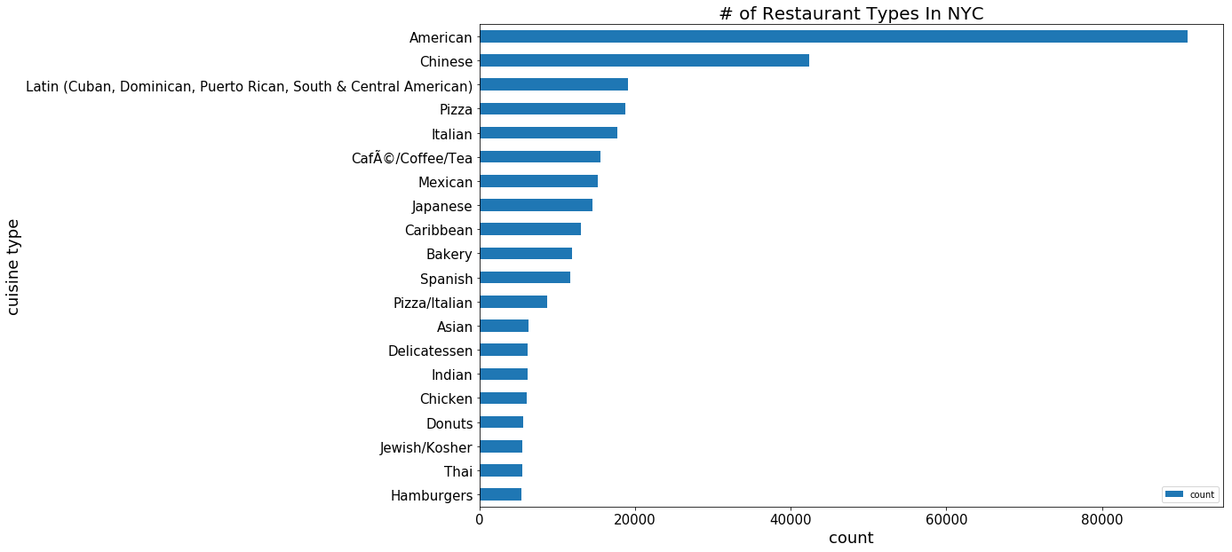
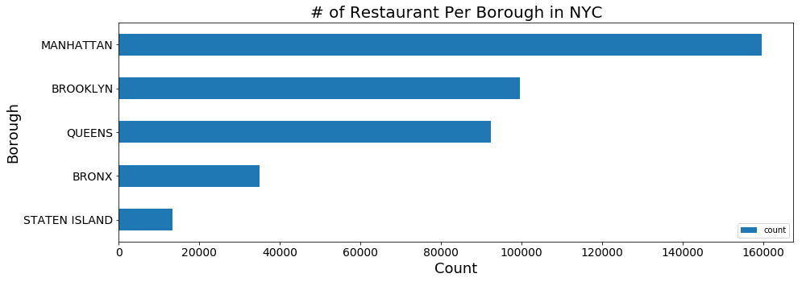
Python Data Analysis Set-up: Import all required software such as pandas dataframe and matlab plot library. Then stream the csv data files uploaded to my IBM Cloud Object Storage and convert it into a dataframe for the analysis set-up.
To get a sense of the population count of all the restaurant types, we manipulate the data frame to group by cuisine description and return a count of the inspected restaurants serving that food type in the dataframe. The figure below shows the population count of the top 20 restaurant types.

Slide 7
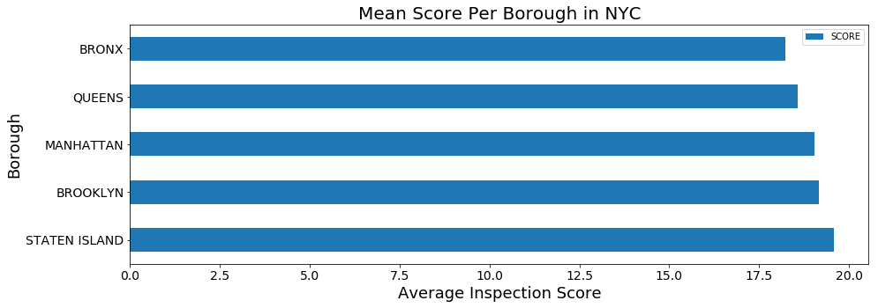
To get the same visualization of which borough has the average inspection violation score, the same methodology is applied with the pandas dataframe.groupby().mean() instead of pandas dataframe.groupby().count() as shown below:

Slide 8
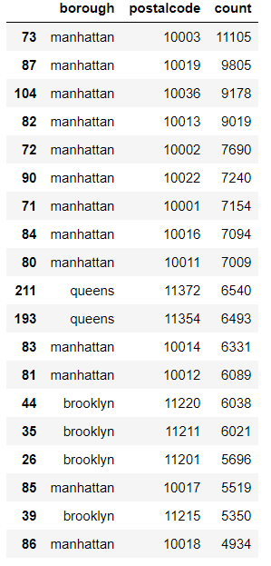
From the graph left, we can tell that Manhattan has the majority of restaurants in numbers(top 10 areas), which means the biggest advantage here is customer flow. For investors looking for stable customer numbers, Manhattan will be the ideal spot.
Brooklyn follows in second place with scattered numbers in the area, which means the restaurant is relatively spread out and less competitive than Manhattan. Investors that are looking for more flexibility in terms of restaurant choice will be more interested in this area.
Queens have 2 areas packed with restaurants while other areas are lacking a big number for restaurants. It shows that there are more opportunities to start a new business and less hourly pay for budget. However, it does face the problem of lacking consistent customers. For investors with a general choice of restaurant and less budget, it will be a good choice.

Slide 9
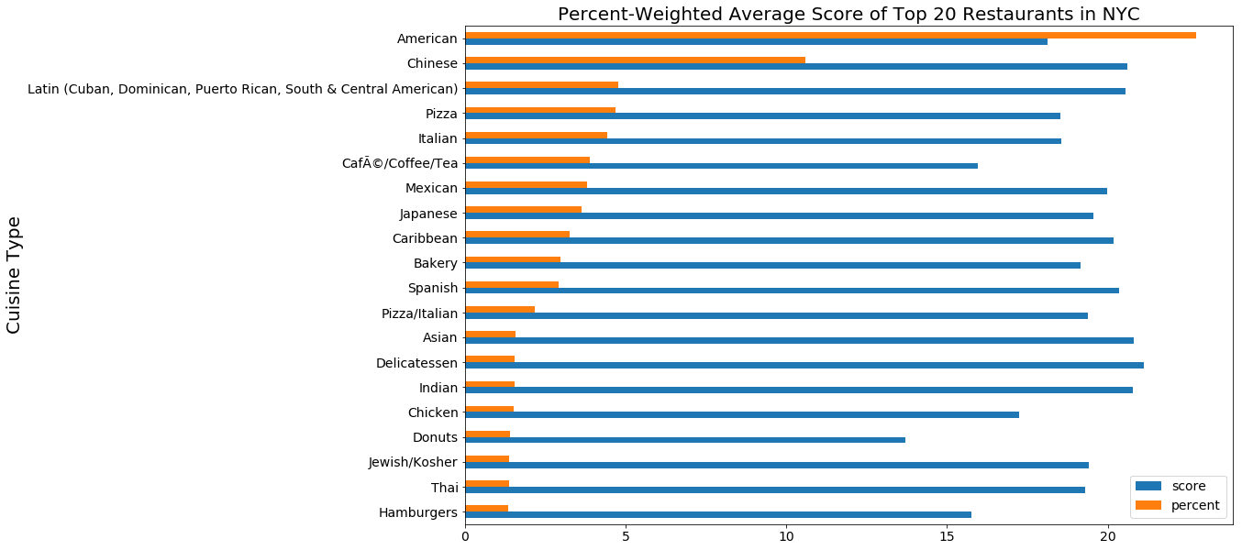
As the above picture shows the top 20 types of restaurants, we can see that American restaurants are the most competitive area with a medium inspection score, which gives investor ideas that american restaurants are one of the most popular types with normal level to pass inspection. Followed by the second tier is convenient food and fine dining. Donuts, coffee and burger types have the best inspection passing rate while Asian and Latin have the least passing rate. It gives a general idea that convenient food and fast food has a higher chance to pass inspection while dining and cooking restaurants have more problems passing inspections.

Slide 10
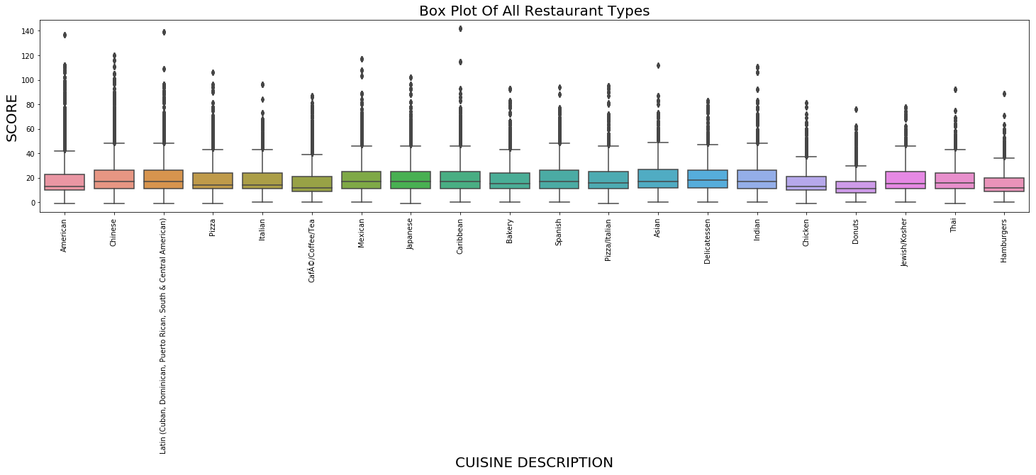
From the box plot we showed below, we can tell that restaurants have on average a similar passing score. However, there are some outstanding points to make. For convenient food like donuts, chicken, coffee and burger, the difference between highest and lowest scores are less than the difference for dining focus restaurants. Within dining restaurants, there are also some differences. Asian, spanish and Mexico have the biggest range for passing score while italian and Thai have relatively small passing range. Which means there is a huge difference between high quality Asian/Spanish/Mexico restaurants and low quality Asian/Spanish/Mexico restaurants. Meanwhile, most restaurants for Italian and Thai are on a similar level.

Slide 11
For investors
For investors with adequate funding and interested in high quality restaurants, Asian, Spanish and Mexico restaurants at Manhattan will be the most ideal choice.
Investors have less funding and are also interested in easy construction, convenient food like donuts and burgers at Brooklyn or Queens will be less competitive and more flexible.
For investors that are looking for a steady inspection passing rate and moderate budget, Italian fine dining fits the criteria the best.

Slide 12
Conclusion
This concludes the comprehensive analysis of the many restaurants in New York City and organized the data to visualize the correlation between the type of food the restaurant serves and the inspection score. We proposed a population percent-weighted mean score visualization to demonstrate to the restaurant investors how critical the inspection violations for the most competitive types. Beyond weighted-average analysis, we further show the various parameters (e.g. max value, range and variance) of scores for the top 20 restaurants.

